Slide 1

IBM Data Science Capstone Project
Modelling Seattle transportation collision using Classification Machine Learning
Long Phan – Climate Change Data Analyst, SNV Vietnam
September 2020
tuanlongphannguyen@gmail.com

Slide 2
Introduction/ Business Problem
In this capstone project, I will choose to work on a transportation problem in Seattle by analyzing the accident characteristic. Transportation accident is one of the most headache issue in any big cities. This problem, fortunately, thanks to the power of data, can be addressed and mitigated. The goal of the project is to help predict future accidents base on key variables, thus finding the ways to reduce collision rate. Beneficiaries from this study are policy makers, drivers, and people working in the transportation sector.

Slide 3
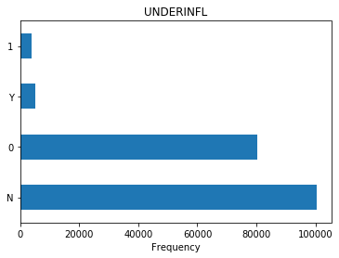
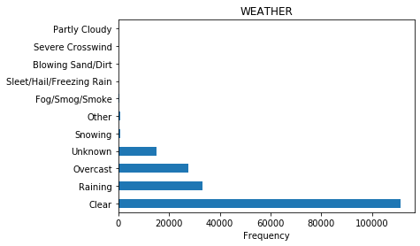
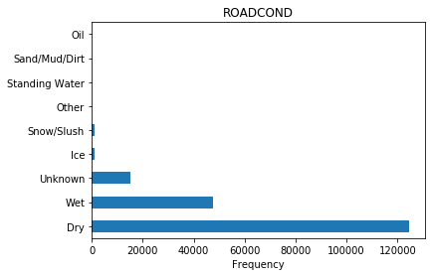
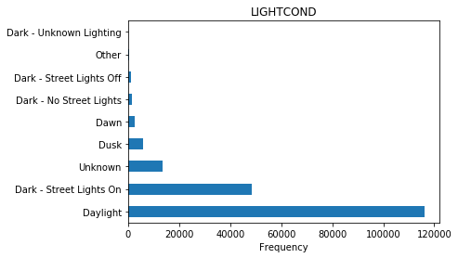
Feature selection

Slide 4
Data relabeling
Attributes | Old value | New re-labeled value
UNDERINFL | Y/N | 1/0
WEATHER | 'Clear', 'Partly Cloudy' | normal
 | 'Raining', 'Overcast', 'Snowing', 'Other', 'Fog/Smog/Smoke', 'Sleet/Hail/Freezing Rain', 'Blowing Sand/Dirt', 'Severe Crosswind' | extreme
ROADCOND | 'Wet', 'Ice', 'Snow/Slush', 'Other', 'Standing Water', 'Sand/Mud/Dirt', 'Oil' | extreme
LIGHTCOND | 'Dark - Street Lights On', 'Dusk', 'Dawn', 'Other', 'Dark - Unknown Lighting' | low_light
 | 'Dark - No Street Lights', 'Dark - Street Lights Off' | dark

Slide 5
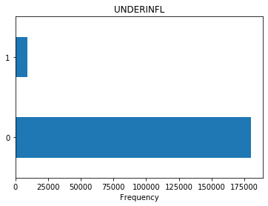
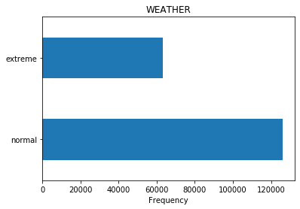
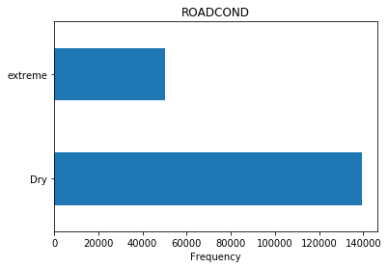
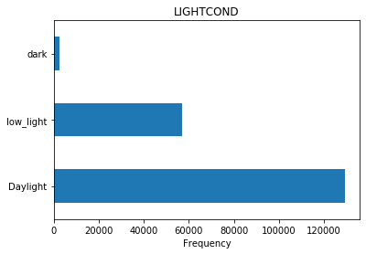
Relabeled Attributes

Slide 6
Classification Modeling methods
Machine Learning methods | Tuning parameter
K-Nearest Neighbor | K value
Decision Tree | Max depth value
Support Vector Machine | Kernel types ('linear', 'poly', 'rbf')
Logistic Regression | Solver types ('newton-cg', 'lbfgs', 'liblinear', 'sag', 'saga')

Slide 7
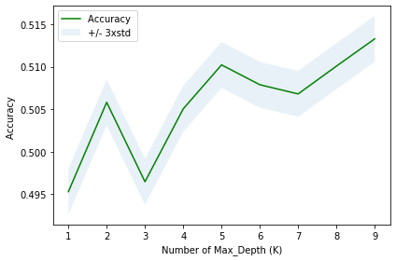
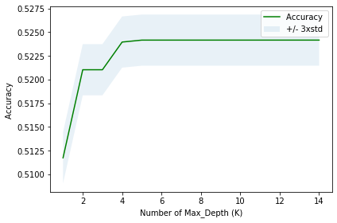
Classification Modeling tuning result
K-Nearest Neighbor (KNN)
Decision Tree

Slide 8
Classification Modeling tuning result
Support Vector Machine
Logistic Regression
Kernel | F1 score | Jaccard score
Linear | 0.5146 | 0.5235
Poly | 0.5142 | 0.5239
RBF | 0.5145 | 0.5241
Solver | F1 score | Jaccard score | Log loss
newton-cg | 0.51467686 | 0.523516 | 0.69147211
lbfgs | 0.51467686 | 0.523516 | 0.69147219
liblinear | 0.51467686 | 0.523516 | 0.691472038
sag | 0.51467686 | 0.523516 | 0.6914720301
saga | 0.51467686 | 0.523516 | 0.69147204

Slide 9
Final Evaluation Result
ML model technique | F1 score | Jaccard score | Log loss
K-Nearest Neighbor | 0.4827 | 0.5102 | -
Decision Tree | 0.5149 | 0.524 | -
Support Vector Machine | 0.5145 | 0.5242 | -
Logistic Regression | 0.5147 | 0.5235 | 0.6914

Slide 10
Conclusion
Recommendation
The study has successfully determined the best machine learning model technique in the Seattle transportation collision dataset.
It uses Severity code as the response vector (target) and four variables (UNDERINFL', 'WEATHER', 'ROADCOND', 'LIGHTCOND) as Feature Matrix. By running through the well-tuned models, Decision Tree and Logistic Regression are proved to be the most appropriate techniques and can be use in further analysis and study.
Due to the limit in CPU cores and speed, this study could not carry the largest extractable dataset for modelling. To achieve this highest possible dataset an up-sample method and replacing n/a with highest frequency are needed. This approach may result better accuracy.
Also due to the computer processing speed, other attribute is currently not taking into account. Further studies may need to approach this issue.

Slide 11
Thank you.

